Slide 1
Interactive Quiz Application
A Web-Based Learning and Assessment Platform
Presented by Paras Sharma

Slide 2
Introduction
The Interactive Quiz Application is a web-based platform
designed to help users practice multiple‑choice questions in a
simple, fast, and interactive way. It allows learners
to select a topic, attempt quizzes, and instantly view their scores.
Built using HTML, CSS, and JavaScript, the application ensures
a smooth user experience while supporting responsive design, feedback submission, and clear navigation.

Slide 3
System Flow Diagram
This diagram shows the flow of the quiz application from Home Page to Quiz Engine, Scoring and Results.
Home Page
Quiz Engine
Score Calculator
Results

Slide 4
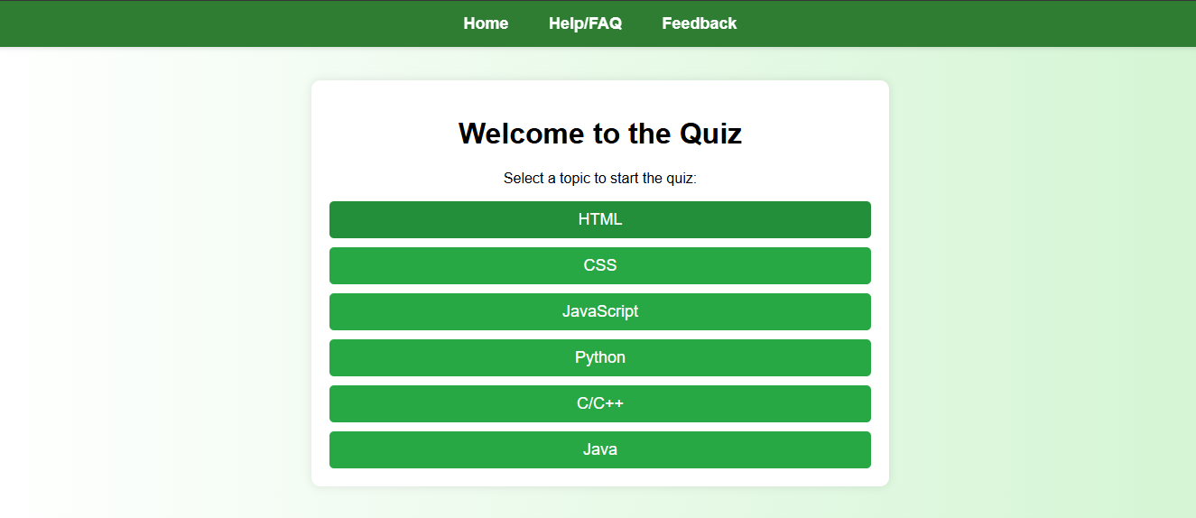
Home Page
The Home Page provides users with category-based quiz selection. Its clean UI and structured layout help users quickly choose between HTML, CSS, JavaScript, Python, C/C++, and Java.

Slide 5
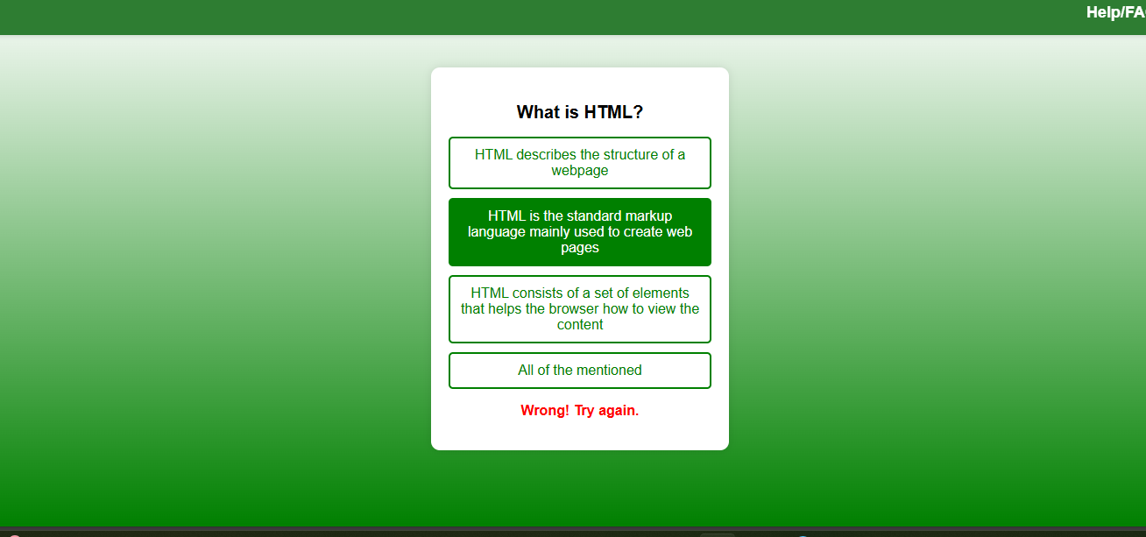
Quiz Interface
This interface displays questions and multiple-choice options. It highlights correct and incorrect answers with immediate visual feedback, enhancing learning.

Slide 6
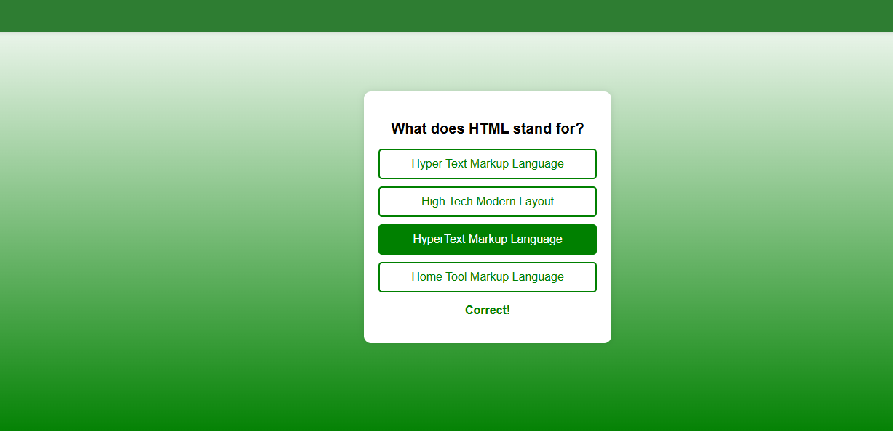
Correct Answer Highlight
The correct answer is highlighted with a positive message, helping users learn instantly and identify mistakes

Slide 7

Leaderboard
The leaderboard shows the user's total score. It helps track performance and encourages users to retry and improve.

Slide 8
UML Use Case Diagram
Select Quiz
User
Attempt Questions
View Results

Slide 9
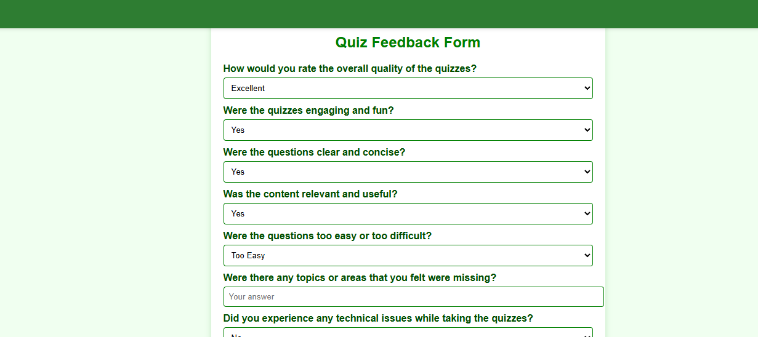
Feedback Form
Users can provide helpful insights through this feedback form. They can report issues, rate quiz difficulty, and suggest improvements for future updates.

Slide 10
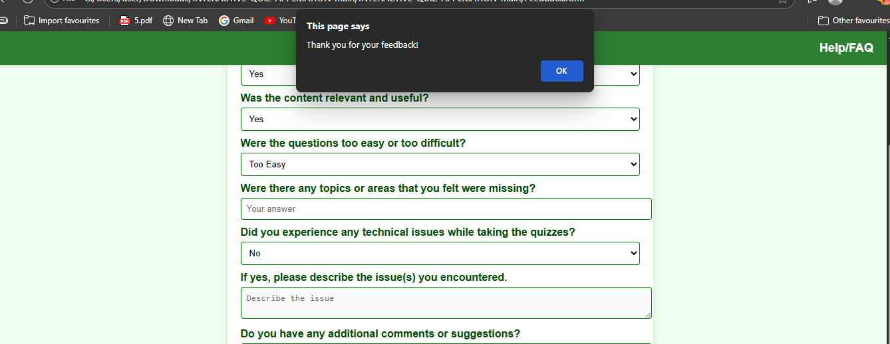
Feedback Confirmation
After submitting feedback, a clean popup confirmation message is shown to reassure users that their response has been recorded successfully.

Slide 11
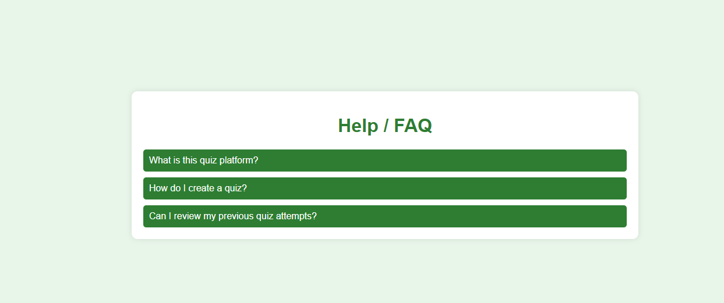
FAQ Section
The FAQ section explains how to navigate the quiz, how results work, and how users can create or retry quizzes. It guides beginners effectively.

Slide 12
Thank You

